Slide 1
Digital Zoom
By Ido W. and Dvir H.
May, 2025

Slide 2
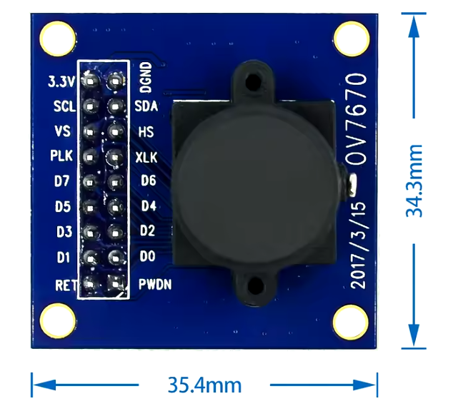
System Overview
Goals:
Implement a digital zoom on FPGA, using the OV7670 camera as input and VGA monitor for display.
Implement zoom x 2
Solve zoom pixelation by Bilinear Interpolation

Slide 3
Project’s steps
Architecture – Key FPGA Modules.
Code implementation (RTL)
Simulations
Synthesis
Place & Route - .xdc

Slide 4
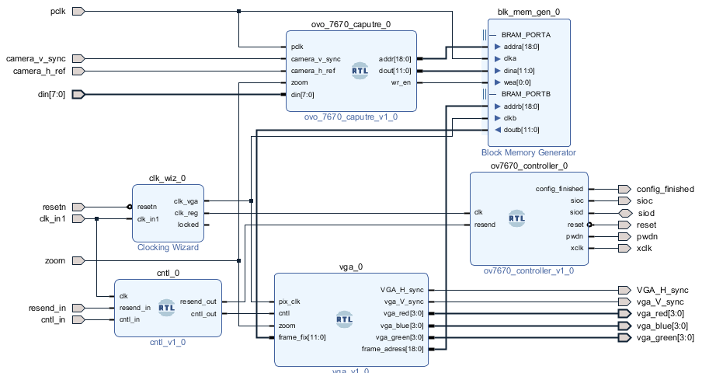
Architecture – Key FPGA Modules.
Initial architecture:

Slide 5
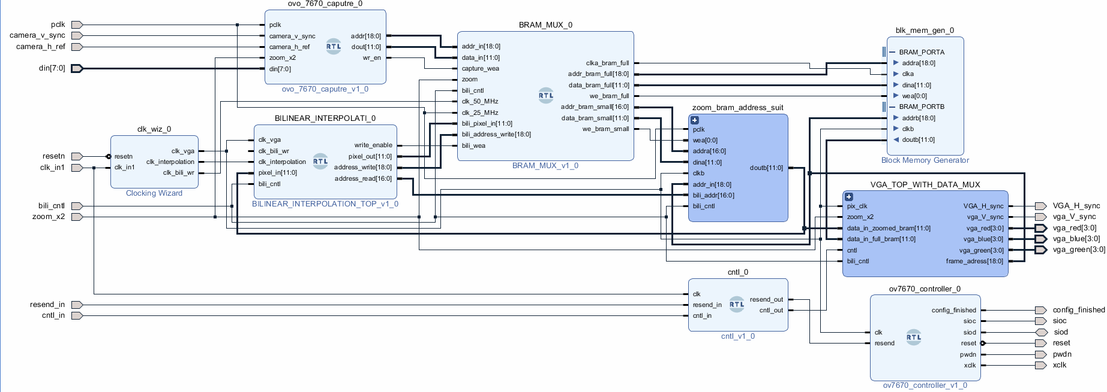
Architecture – Key FPGA Modules.
Final architecture:

Slide 6
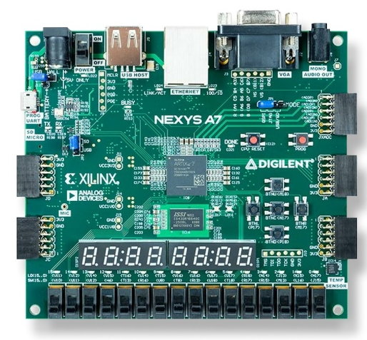
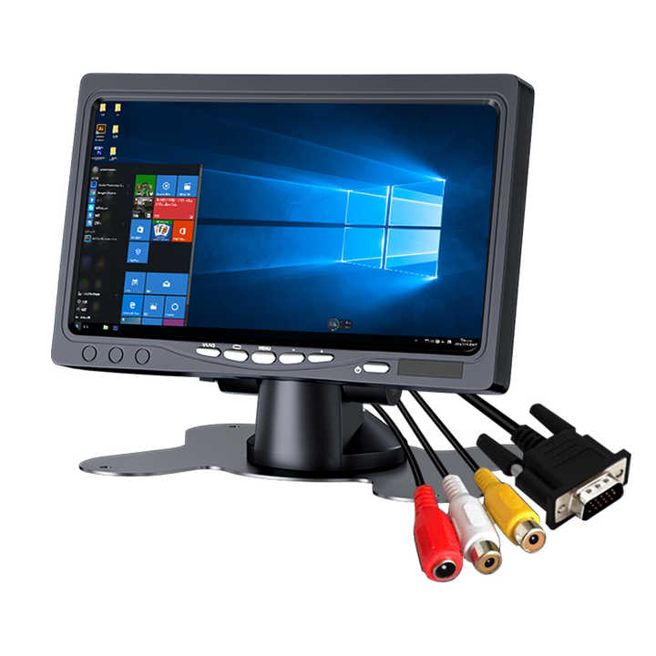
Flow
Pixels data, clk, sync signals
Config, clk, reset
Sync signal, pixels

Slide 7
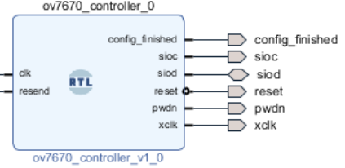
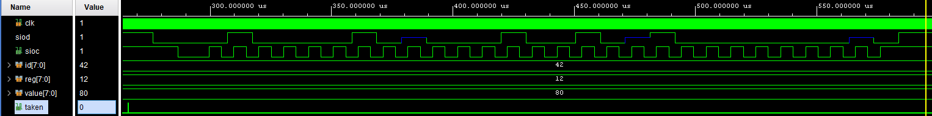

Module: Controller
Config, clk, reset
Configure registers with protocol SccB (I2C like), 97.65KHz
$f_{SIOC}=\frac{25Mhz}{256}≈100KHz$
B"01000010" = x"42"
B“1000_0000" = x“80"

Slide 8
Two Content Layout with Table
First bullet point here
Second bullet point here
Third bullet point here
Class | Group 1 | Group 2
Class 1 | 82 | 95
Class 2 | 76 | 88
Class 3 | 84 | 90

Slide 9
Title and Content Layout with SmartArt
Step 1 Title
Step 2 Title
Task description
Task description
Task description
Task description
Task description
Task description
Task description
Step 3 Title
Task description
Task description
Step 4 Title
Task description
Task description

Slide 10
Add a Slide Title - 1

Slide 11
Add a Slide Title - 2

Slide 12
Add a Slide Title - 3

Slide 14
Add a Slide Title - 4

Slide 15
Add a Slide Title - 5

